Slide 1


NYC Airbnb Pricing Analysis Team 6 Bhasin, Mahima Mantena, Manohar Murthy Raju Mungi, Swapnil Nanganuri, Bharath kalyan Panda, Simran Shah, Het Roak Talari, shiva

Slide 2
Agenda
Abstract
Introduction
Data Analysis
Results
Conclusion
Methodology

Slide 3
Abstract
Airbnb's Disruptive Impact on Travel and Hospitality
- Airbnb's emergence has fundamentally reshaped traditional travel and accommodation paradigms.
- It democratizes hospitality, enabling individuals worldwide to host guests.
- Represents a significant departure from conventional hotel-centric models.
Research Objective is to Uncovering Key Factors in Airbnb Pricing
- Focuses on identifying critical determinants shaping Airbnb pricing strategies.
- Aims to elucidate the causal relationships between various elements and listing prices.
Data-driven Analysis Using Inside Airbnb
- Draws insights from a vast dataset of over 42,000 listings in New York City.
- Harnesses rich information to inform pricing dynamics and market behavior.
Broader Implications for Stakeholders
- Empowers travelers and hosts with data-driven decision-making tools.
- Equips policymakers with insights into the sharing economy's impact on markets.
- Contributes to enhanced consumer protection and fostering fair competition.

Slide 4
Introduction
Examining:
By uncovering the factors shaping Airbnb pricing within the sharing economy, this study enhances understanding for scholars, practitioners, and policymakers across economics, business, and politics.
Techniques We'll analyze Airbnb data using econometric tools, considering factors like cost, location, home type, amenities, host characteristics, and guest reviews, ensuring validity with robustness tests.
Research Question Analyzing the factors influencing Airbnb pricing decisions like influence of location, house type, amenities, and host characteristics on pricing decisions.
Motivation Airbnb pricing informs hosts and guests, while guiding policymakers on fair competition and consumer protection.
In an ever-evolving aviation industry, characterized by continuous growth in passenger numbers and flight operations, increased investments in airport and aircraft capacity are crucial, yet challenges such as peak hour congestion and environmental impact persist, while the formation of alliances among carriers necessitates stringent oversight from aviation authorities to prevent market power abuses, all within the context of a dataset spanning 1997 to 2000, capturing the dynamics of economic growth and technological advancements alongside challenges leading up to the 2001 recession, offering a unique perspective on airline passenger responses to changing economic conditions.

Slide 5
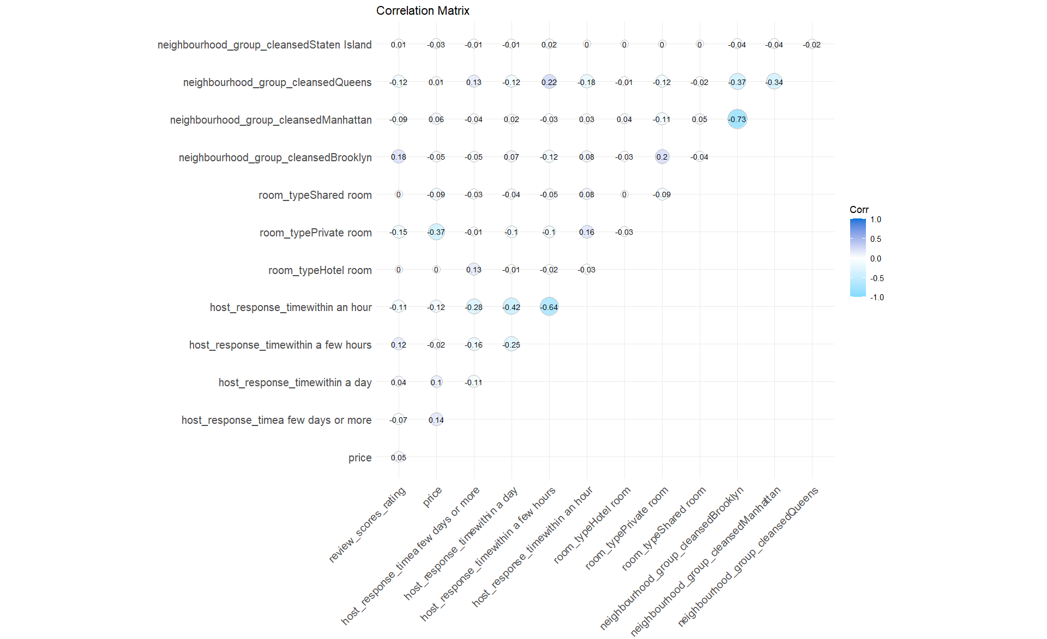
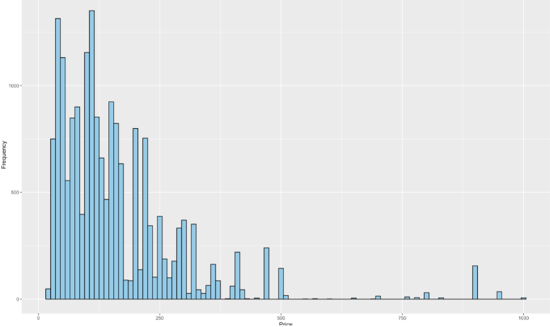
Methodology
Equation:
Listings_Price = a + b*room_type + c*neighbourhood + d*review_scores_rating + e*host_response_time + f
2
Variable Transformation: Before estimating our model using the chosen regressor and predictors, it's crucial to examine their distributions and address any non-normality. We noted considerable skewness in the Price variable during this process, evident from the histogram.
1
Variable Selection: High correlations among variables like "neighbourhood_group" suggest multicollinearity, complicating regression analysis and potentially leading to imprecise estimates and omitted variable bias.

Slide 6
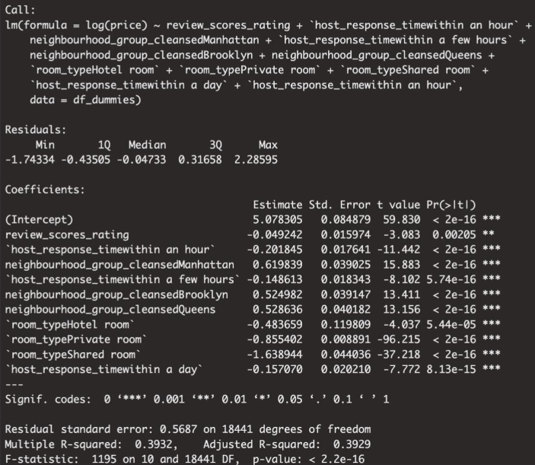
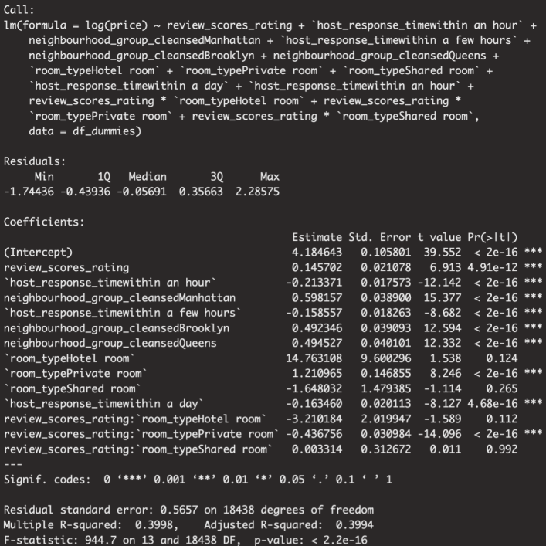
Methodology
3
Model Selection
We found that the interaction term review_scores_rating * room_typeShared room wasn't statistically significant.
We iteratively remove less significant features to enhance the model's predictive power or interpretability.

Slide 7
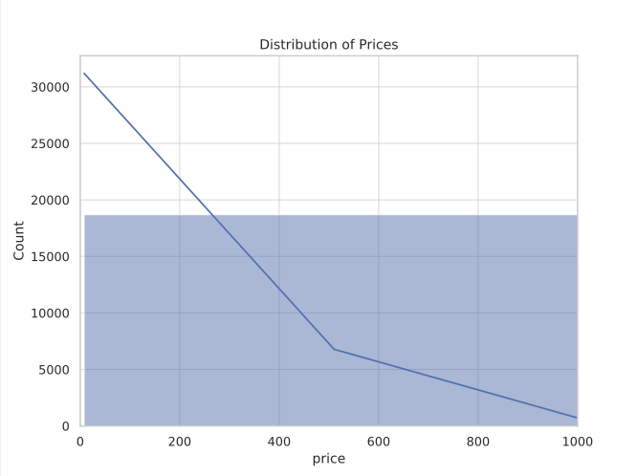
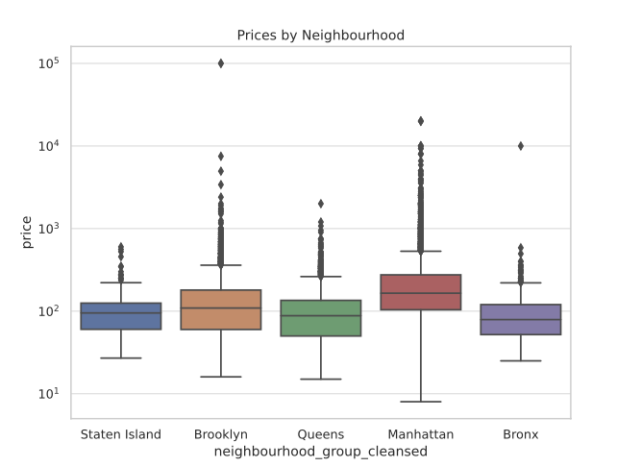
Exploratory Data Analysis
1
2
Prices by Neighbourhood: Neighborhood-based boxplots show diverse median prices, with some areas commanding higher rates, possibly due to popularity or centrality; a logarithmic scale aids in visualizing data distribution and outliers.
Distribution of Prices : The histogram of listing prices reveals a right-skewed distribution, with the majority below $1000, indicating the rarity of higher-priced listings.

Slide 8
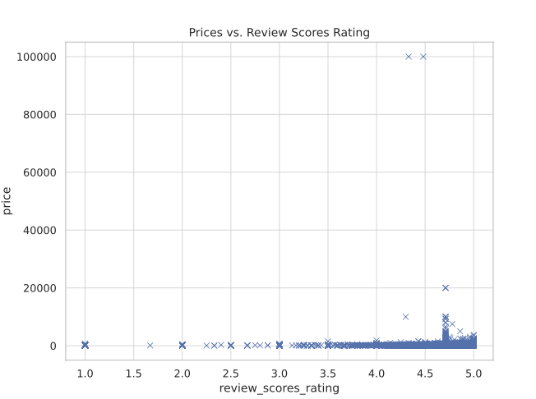
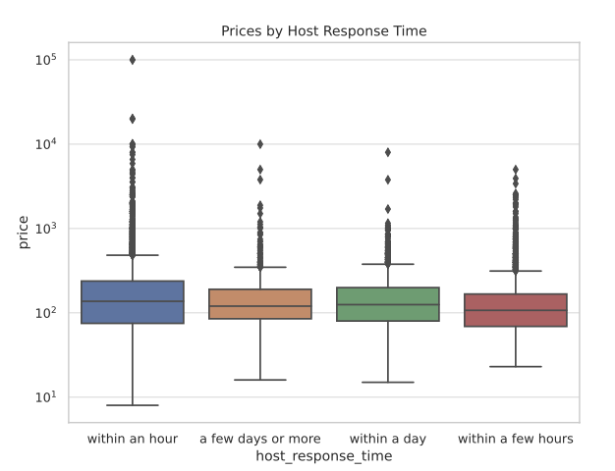
Exploratory Data Analysis
3
4
Prices by Host Response Time: Faster host response times may correlate with higher prices, indicating the value placed on responsiveness and its potential impact on pricing.
Prices vs. Review Scores Rating: The scatter plot of prices versus review scores indicates no strong correlation, suggesting that higher prices don't necessarily mean higher ratings.

Slide 9
Results
1. Positive Correlation with Review Scores
Properties with higher review scores tend to have higher prices.
Coefficient: 0.14534, p-value < 2e-16
2. Impact of Host Response Time
Listings with faster host response times exhibit lower prices.
Coefficient: -0.21245, p-value < 2e-16
3. Neighborhood Influence
Neighborhoods like Manhattan, Brooklyn, and Queens command higher prices.
Coefficients: Manhattan (0.59815), Brooklyn (0.49249), Queens (0.49508); all with p-values < 2e-16
4. Room Type Differentiation
Private rooms are associated with higher prices.
Shared rooms tend to have lower prices.
Private room Coefficient: 1.20879, Shared room Coefficient: -1.63241; both with p-values < 2e-16
5. Model Improvement. Our final model, which included host response times, room types, and neighborhood groups, achieved an adjusted R-squared of 0.3993. This model not only confirmed the importance of geographical location but also highlighted the significant roles of host responsiveness and room types in determining prices. The model’s F-statistic was highly significant, indicating a robust fit.

Slide 10
Conclusion
Properties with higher review scores are priced higher, indicating a correlation between customer satisfaction and willingness to pay more.
Faster host response times correlate with lower listing prices, which could point to hosts valuing quick booking turnovers.
Locations within Manhattan, Brooklyn, and Queens command a premium, reflecting the demand and scarcity in these desirable areas.
Private rooms are priced higher than entire homes or apartments, suggesting a market valuation for privacy and exclusive amenities.
Shared rooms are the most economical option, aligning with market expectations for shared living spaces.
The influence of review scores on pricing is less pronounced for private rooms, hinting at additional factors that might play a more significant role in pricing decisions for these listings.

Slide 11
Thanks

